Slide 1
DREAM DOCK
Innovative Infant Care
TEAM GUIDE
Dr.P.Kalpana
TEAM MEMBERS
1602-21-748-016 Laxman Kumar Gajji
1602-21-748-021 Manasa Karumuru

Slide 2

INTRODUCTION
Challenges in Modern Childcare
In today's fast-paced world, childcare has become a significant hurdle, especially for working mothers balancing professional and personal responsibilities.
Although constant care is essential, parents can’t always monitor their infants around the clock due to demanding routines.
Many parents find daycare facilities unsatisfactory, and while hiring caregivers is an option, it’s not always affordable or reliable.
This situation highlights the need for an innovative solution to bridge the gap between infants and parents while offering real-time monitoring and care.

Slide 3
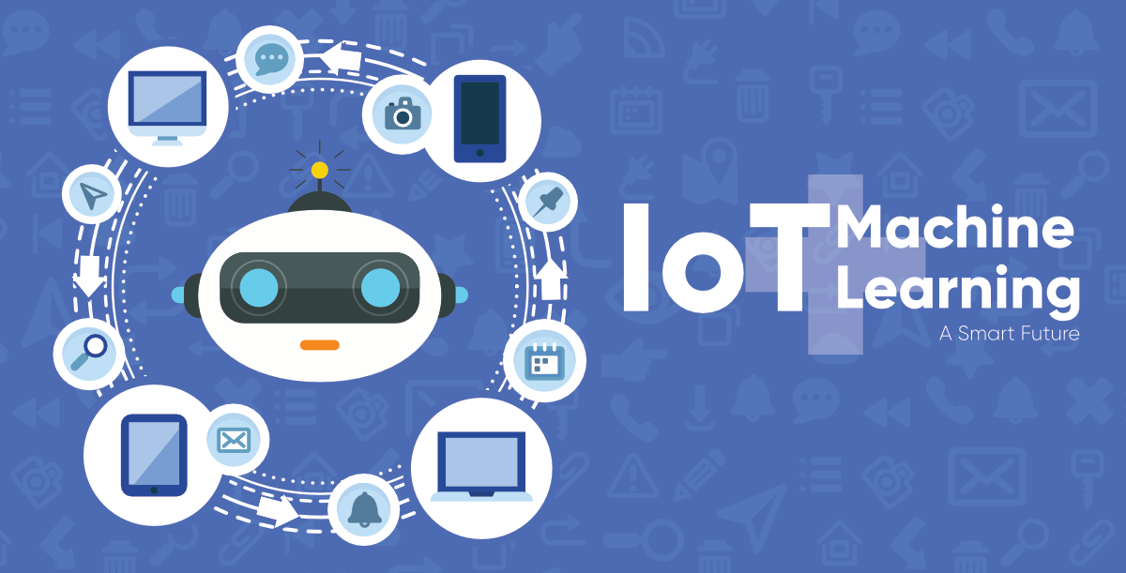
INTRODUCTION
The Role of IoT and Machine Learning in Childcare
The Internet of Things (IoT) is transforming industries by connecting billions of smart devices to automate and streamline daily life.
In childcare, IoT enables the integration of smart objects and sensors that collect real-time data, reducing human intervention and increasing automation.
Machine learning (ML), in tandem with IoT, plays a key role in applications like smart homes and healthcare by analyzing data for real-time insights.
The synergy of IoT and ML can address the unique challenges of childcare, providing a smarter, more responsive solution for modern families.

Slide 4
INTRODUCTION
Dream Dock: An IoT-based Real-Time Baby Monitoring System
Our Dream Dock is designed to support working parents by providing continuous monitoring of their infants.
Key features include:
Live Streaming and Emotion Recognition: Equipped with a camera for live video and ML-powered facial recognition to interpret infants' expressions.
Sensor Integration: Includes a cry-detection mic, wetness sensor, and DHT11 for temperature and humidity monitoring, all controlled through NodeMCU and a Raspberry Pi.
Remote Control via App: Allows parents to monitor, receive alerts, and control cradle hardware directly from their mobile devices, ensuring peace of mind and continuous care.

Slide 5
Literature Survey
Hatch Baby Rest
Features:
Smart night light and sound machine.
Offers mobile app for remote control.
Programmable timers for sleep routines.
Lacking Features:
No physical cradle for baby to sleep in.
Limited monitoring capabilities compared to dedicated baby monitors.

Slide 6
Literature Survey
Snoo Smart Sleeper
Features:
Built-in microphones and sensors detect baby's cries and movements.
Automatically responds with gentle rocking motions and white noise to soothe the baby.
Offers mobile app for remote monitoring and control.
Lacking Features:
Limited customization options for soothing settings.
Detects every noise as cry.

Slide 7
Literature Survey
Nanit Pro Smart Baby Monitor and Floor Stand
Features:
Overhead camera with live HD video and sound monitoring.
Sleep tracking and analysis based on baby’s movements.
Real-time notifications to parents’ devices and sleep insights.
Lacking Features:
No built-in soothing motions like rocking or white noise.
Does not have sensors for humidity, wetness, or temperature control.

Slide 8
PROPOSED METHODOLOGY
The proposed solution involves live monitoring of the child through a mobile application remotely.
Noise Sensor for the detection of the child's crying activity.
Utilizes ML to analyze and recognize facial expressions, vocalizations, and body movements, providing insights into the infant’s emotional state.
When crying is detected, cradle is rocked and sends notification to parent.
The Thermal sensor notifies the parent about the environmental temperature near the baby and switch on the fan automatically with temperature.
The proposed system uses the cloud service for remotely monitoring the child.

Slide 9
IMPLEMENTATION
Requirements:
Define core features, including the ML model for emotion detection and sensor integration.
Identify hardware and software needs (sensors, microcontroller, camera, ML libraries).
Design:
Plan system architecture, data flow, and design the ML model structure for emotion recognition.
Implementation:
Train the ML model with relevant infant emotion data.
Integrate model with the cradle’s camera feed for real-time emotion recognition.
Develop the mobile app for remote monitoring and notifications.
Testing:
Validate the ML model’s accuracy in detecting emotions.
Test overall system performance to ensure reliable notifications.
Deployment:
Set up the cradle in a real environment for hands-on testing with parental supervision.
Maintenance:
Update and retrain the ML model as needed to improve emotion recognition accuracy.
Routine checks on sensors and software for smooth functionality.

Slide 10
CONCLUSION
The Dream Dock project presents an innovative solution to enhance infant care by integrating modern sensors, actuators, and connectivity features into a traditional cradle design.
By providing real-time monitoring, automated soothing mechanisms, and insights into the baby's health and sleep patterns.
The Dream Dock system aims to revolutionize the way infants are cared for, offering peace of mind to parents and ensuring the safety and comfort of their babies.

Slide 11
REFERENCES
https://www.geeksforgeeks.org/project-idea-baby-monitoring-smart-cradle/
https://link.springer.com/referenceworkentry/10.1007/978-3-030-84205-5_166
https://www.irjet.net/archives/V10/i8/IRJET-V10I849.pdf
https://www.semanticscholar.org/paper/Smart-Baby-cradle-Patil-Patil/b0632701e84480b71df2cc0e86bf9f8f55bc9da2
https://www.researchgate.net/publication/329066291_Smart_Baby_cradle
S. Joseph, A. Gautham.J, A. Kumar and M. K. Harish Babu, "IOT Based Baby Monitoring System Smart Cradle," 2021 7th International Conference on Advanced Computing and Communication Systems (ICACCS), Coimbatore, India, 2021

Slide 12
THANK YOU

